Slide 1

Symptom Extraction and Disease Classification from Descriptions and Phenotypes
Chronic Obstructive Pulmonary Disease V.S. Other Pulmonary Disease
Xiaoliang (Toby) Zhu

Slide 2
Agenda
Background Information
Problem Detailing
Literature review
Approaches
Data
Methods
Result Demo
Discussions
Implications
Limitation and Future work

Slide 3
What is COPD?
Chronic obstructive pulmonary disease (COPD) is a chronic inflammatory lung disease that causes obstructed airflow from the lungs.
Symptoms include breathing difficulty, cough, mucus (sputum) production and wheezing.
It's typically caused by long-term exposure to irritating gases or particulate matter, most often from cigarette smoke.

Slide 4
Why we care about COPD?
People with COPD are at increased risk of developing heart disease, lung cancer and a variety of other conditions.
COPD is not curable; the symptoms and its progression can only be delayed.
The main symptoms are similar with symptom of bronchitis or cold. Around 80% of patients entered stage III before diagnosis.
COPD progressively worsens with everyday activities such as walking or dressing becoming difficult.
As of 2015, COPD affected about 174.5 million people (2.4% of the global population). In 2019 it caused 3.2 million deaths.

Slide 5
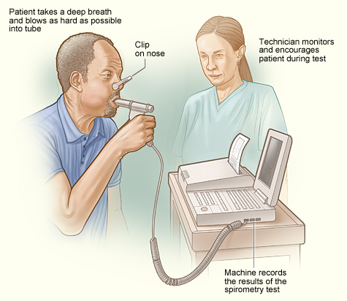
How is diagnosis?
Spirometry measures the amount of airflow obstruction present.
Chest X-ray / CT scan is useful only in excluding other conditions or including some comorbidities.
The use of COPD Diagnostic Questionnaire with hand-held flow meters is appropriate for screening of COPD in primary care.
Text mining methods identify pertinent and potentially complex information about phenotypes from textual data.

Slide 6

How can we distinguish COPD from other pulmonary diseases & identify corresponding symptoms?

Slide 7
Literature Review
Data source: Electronic health records (EHRs)
Most studies of Chronic Diseases focused on diseases of the circulatory system while endocrine and metabolic diseases were fewest.
Structure of clinical records
2009: Blanca E. Himes et al. used Bayesian networks on EHRs to predict COPD, accuracy 83.3% ^{[3]} .
2017: Ankur Agarwal et al. used cTAKES to extract features and predict using NB, RF, KNN, SVM. AUC around 62% ^{[1]} .
2017: Mäkikyrö EM used LCA on clinical questionnaire data to classify phenotypes ^{[4]} .

Slide 8

Approaches
Data
Papers + online platform records
Method:
Word vector + clustering
Text classification
Name Entity Recognition (NER)

Slide 9
Data
COPD corpus ^{[5]}
A semantically annotated corpus, focused on phenotypic information, consisting of 30 full-text articles.
- Around 6000+ sentences with an average length of 11~15.
Example sentence:
COPD staging based on pulmonary function testing done prior to the present episode of ER visit as per the Global Initiative for Chronic Obstructive Lung Disease (GOLD) staging [1] and details regarding co-morbid conditions are depicted in Table 1. Majority of the males (64.8%) smoked bidis. All women gave a history of exposure to domestic fuel such as dried cow dung cakes, wood, dried coconut shells, crop residues and grass.

Slide 10
Data
COVID-Dialogue-Dataset ^{[6]}
An English medical dialogue dataset about COVID-19 and other types of pneumonia. Patients who are concerned that they may be infected by COVID-19 or other pneumonia consult doctors and doctors provide advice. There are 603 consultations.
Built from [icliniq.com], [healthcaremagic.com], and [healthtap.com].
Contains descriptions of patient’s medical condition and dialogues.
Example sentence
I was diagnosed with pneumonia on june 30. I finished taking my antibiotics and cough pills. I still continue to cough sometimes gaging. Shortness of breath and wheezing, I have an inhaler, I am not coughing up anymore phlem.

Slide 11
Data
The NCBI Disease Corpus ^{[2]}
A collection of 793 PubMed abstracts fully annotated at both mention and concept levels.
CONLL-U is a standard format followed to annotate data at sentence level and at word/token level.
Example:

Slide 12
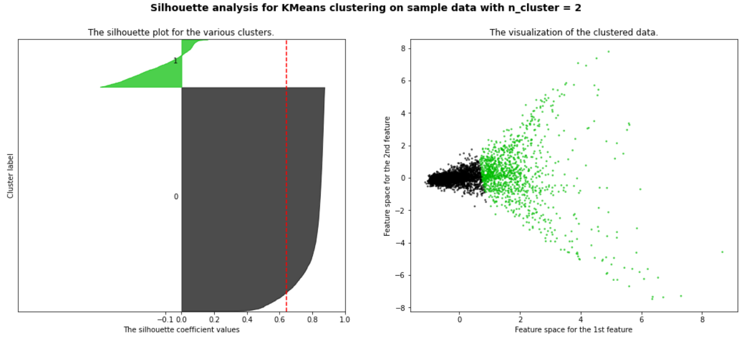
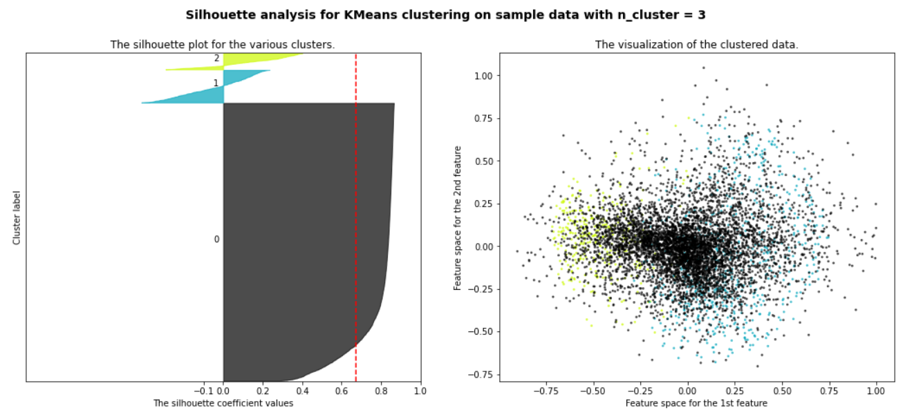
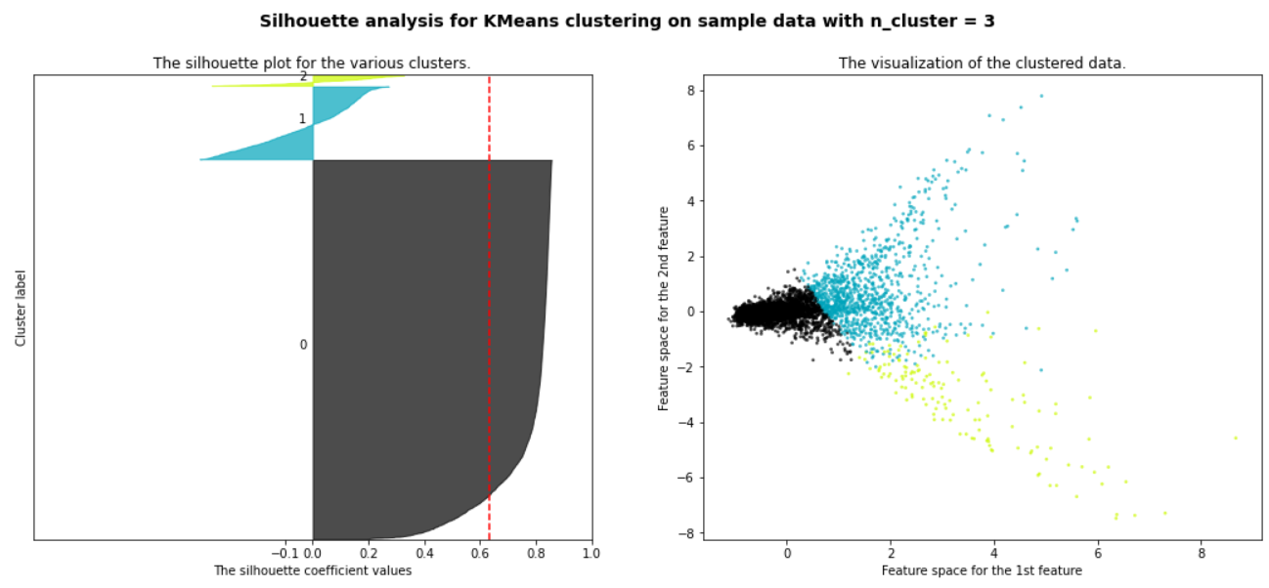
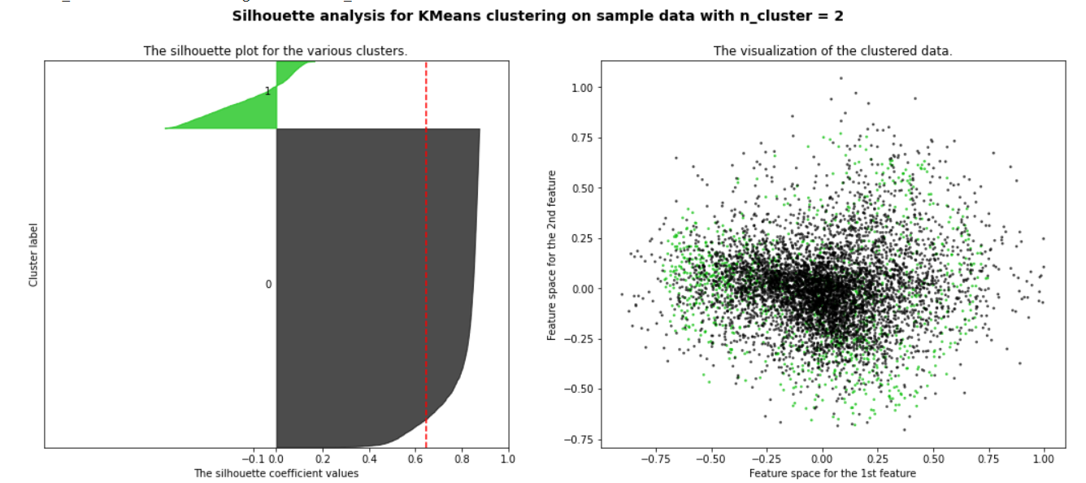
Word Vector + Clustering
Word2Vec creates word vectors for corpus together.
K-means clustering with n_cluster=2, 3.
Kernel-PCA for visualization
Cosine kernel

Slide 13
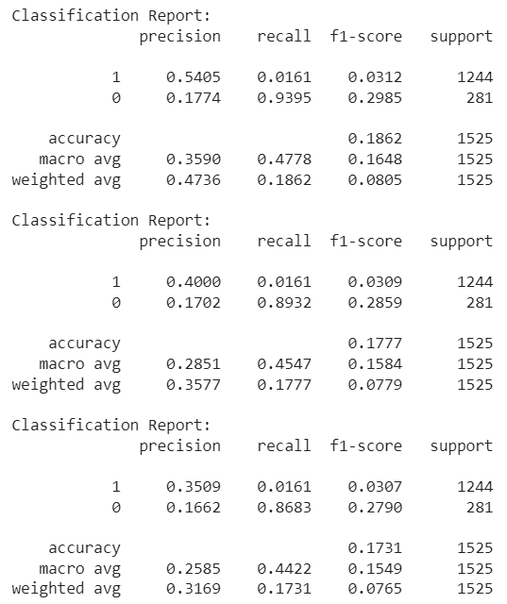
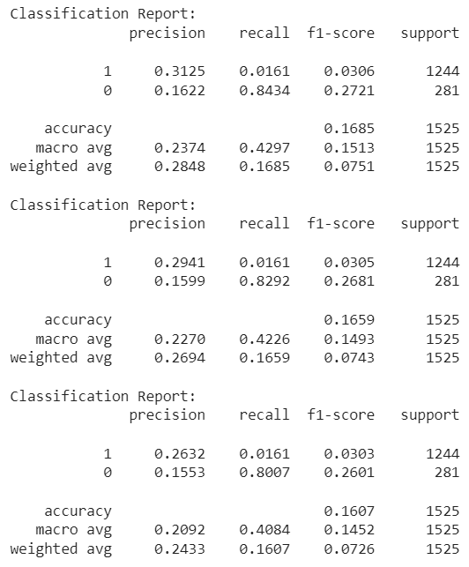
Word Vector + KNN
K=5
K=20
K=10
K=25
K=30
K=15

Slide 14
Text Classification
Bi-LSTM
- Embedding Layer + bi-LSTM Layer + Linear + Sigmoid
BERT
BertForSequenceClassification
BERT + Dropout + Linear + Sigmoid + Linear + Sigmoid
Unbalanced class:
- Add class weights on the loss function

Slide 15
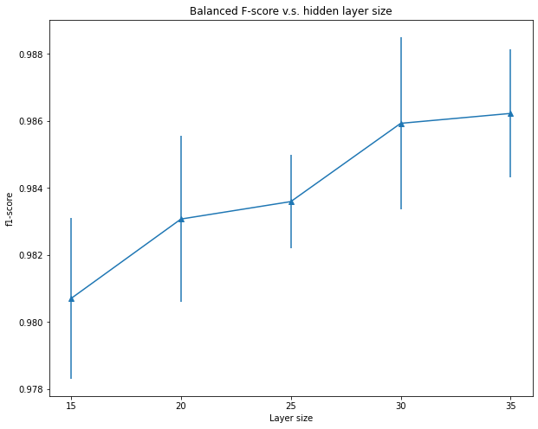
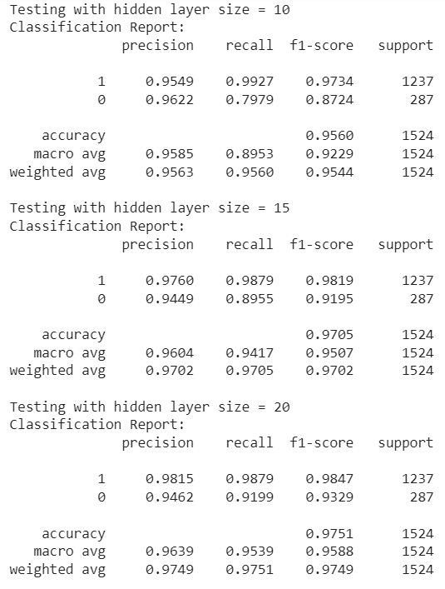
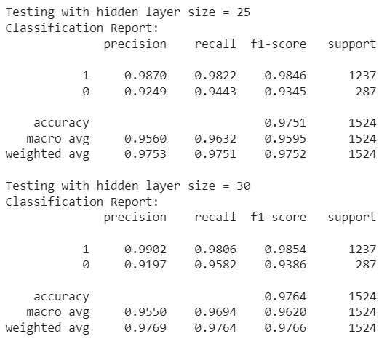
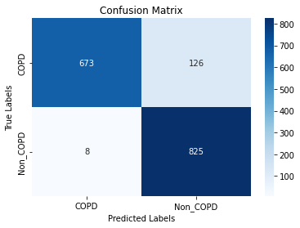
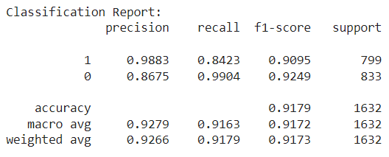
Text Classification (Bi-LSTM)
10-fold CV
Testing

Slide 16
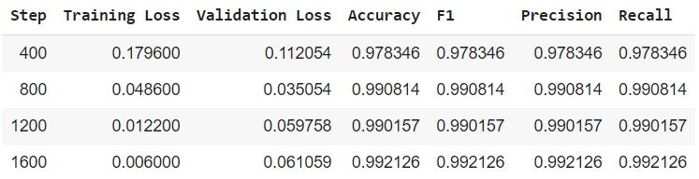
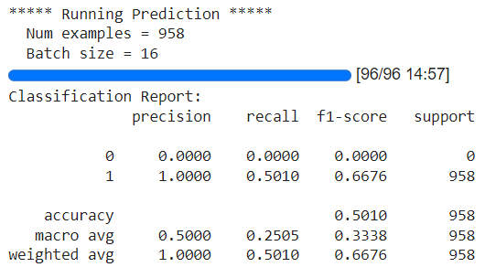
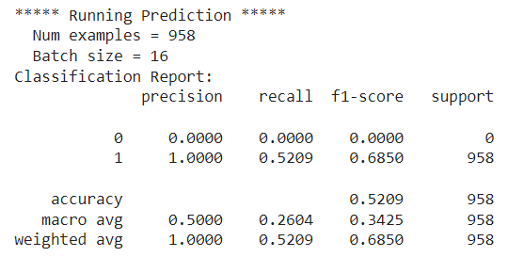
Text Classification (BERT)
Unbalanced Class
Testing

Slide 17
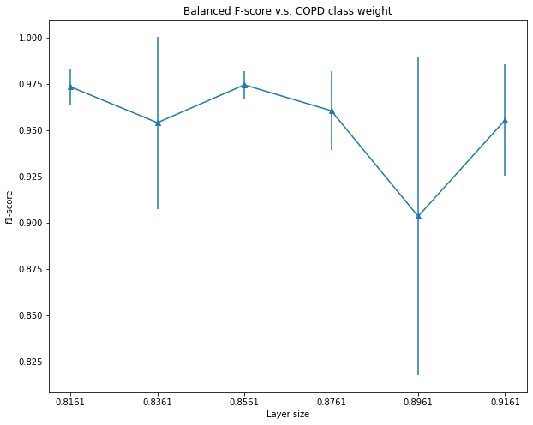
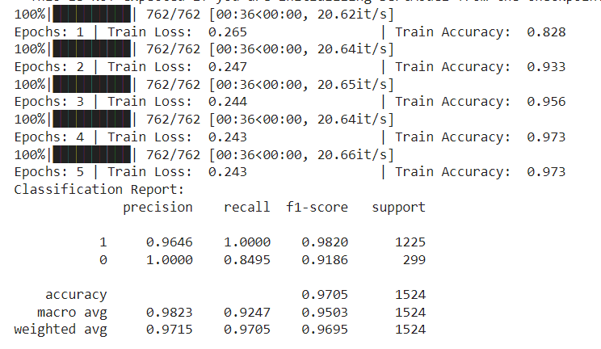
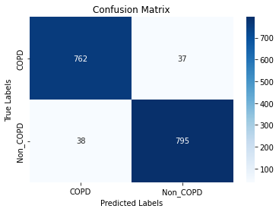
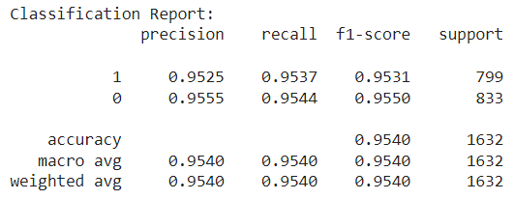
Text Classification (BERT)
9-fold CV
Testing

Slide 18
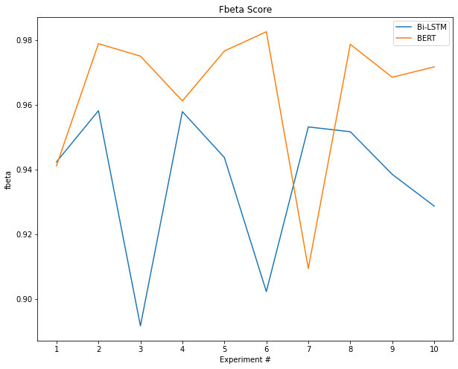
Text Classification
Bi-LSTM
BertClassifier
Ttest_relResult:
statistic=2.3197889631533197
pvalue=0.04550152539372738

Slide 19
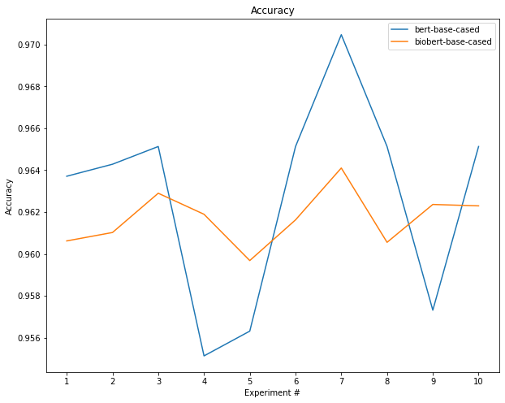
Name Entity Recognition
bert-base-cased
biobert-base-cased
Ttest_relResult:
statistic=0.7588024830400495
pvalue=0.46737687583336684

Slide 20
Principal findings & Results
Demo of the COPD doctor Bot

Slide 21
Implication & Limitation
Potential in using complicated ANN structure for COPD classification
Potential help on self-identifying symptoms and seeking diagnosis in early stages
Limitation on data – EHRs / Consulting description
Limitation on data – annotations
Comparison to other machine learning models – LR, RF, SVM
Speed limitation – more model & complicated structures
Deployment issues

Slide 22
Future work
Comparison to other machine learning models
Experiment on BiLSTM-CRF model
Develop NER model on dataset of specific diseases
Expand to other types of diseases

Slide 23
[1]. Agarwal, Ankur, et al. "A natural language processing framework for assessing hospital readmissions for patients with COPD." IEEE journal of biomedical and health informatics 22.2 (2017): 588-596. [2]. Doğan RI, Leaman R, Lu Z. NCBI disease corpus: a resource for disease name recognition and concept normalization. J Biomed Inform. 2014 Feb;47:1-10. doi: 10.1016/j.jbi.2013.12.006. Epub 2014 Jan 3. PMID: 24393765; PMCID: PMC3951655. [3]. Himes, Blanca E., et al. "Prediction of chronic obstructive pulmonary disease (COPD) in asthma patients using electronic medical records." Journal of the American Medical Informatics Association 16.3 (2009): 371-379. [4]. Mäkikyrö, Elina, Maritta S. Jaakkola, and Jouni JK Jaakkola. "Subtypes of asthma based on asthma control and severity: a latent class analysis." Respiratory research 18.1 (2017): 1-11. [5]. Meizhi Ju, Andrea D. Short, Paul Thompson, Nawar Diar Bakerly, Georgios Gkoutos, Loukia Tsaprouni and Sophia Ananiadou (2019). Annotating and Detecting Phenotypic Information for Chronic Obstructive Pulmonary Disease. JAMIA Open, ooz009, https://doi.org/10.1093/jamiaopen/ooz009 [6]. @article{chakravorty2020COVIDDialogueDatasetEnglish, title={COVID-Dialogue-Dataset-English: an English medical dialogue dataset about COVID-19 and other types of pneumonia}, author={Chakravorty, Subrato and He, Xuehai and Yang, Xingyi and Xie, Pengtao}, journal={ https://github.com/UCSD-AI4H/COVID-Dialogue}, year={2020}}
Reference

Slide 24

QUESTIONS

